Slide 1




Leetcode Strategies

Slide 2

PROJECT TITLE:
CONQUERING THE CODE: STRATEGIES AND LEARNINGS FROM LEETCODE
Content:
Unlocking Your Coding Potential (Focuses on personal growth)
Mastering Algorithms and Data Structures (Highlights technical skills)
From Beginner to Pro: A LeetCode Journey (Showcases your experience level)
Sharpen Your Skills: LeetCode Strategies for Success (Action-oriented approach)

Slide 3
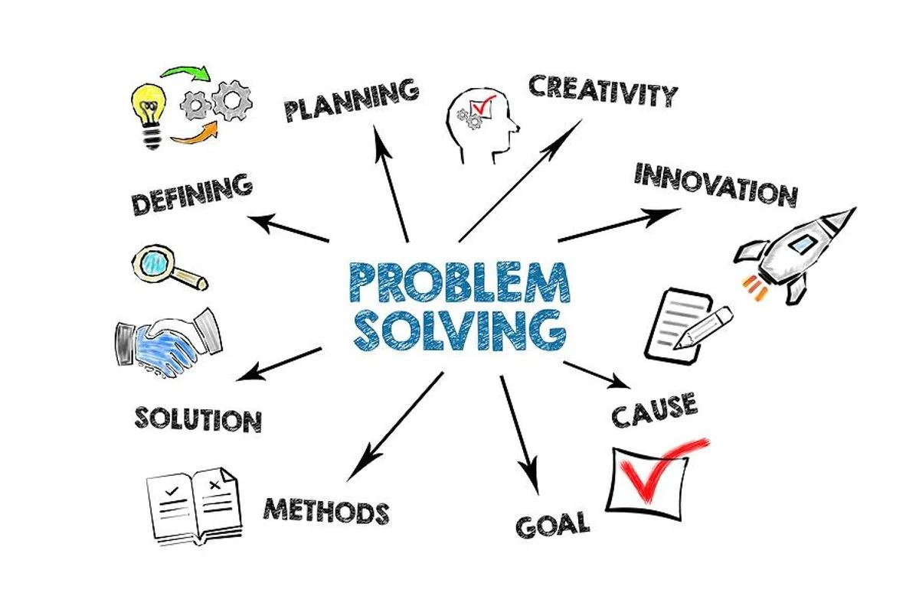

Slide 4
TITLE: SHARPENING YOUR PROBLEM-SOLVING SKILLS
Understand the Problem: Before coding, grasp inputs, outputs, and edge cases.
Visualize the Solution: Sketch diagrams or use tables to break down complex problems.
Explore Approaches: Consider alternative algorithms and data structures.

Slide 5

TITLE: LEETCODE TIPS FOR EFFECTIVE LEARNING
Master Basics First: Focus on core algorithms and data structures before jumping in .
Practice Makes Perfect: Set dedicated time for regular LeetCode practice.
Learn from Mistakes: Analyze errors, review discussions, and use online resources.
Join the Community: Leverage LeetCode's community for discussions and learning.

Slide 6

TITLE: THE REWARDS OF LEETCODE PRACTICE
Home
Service
About Us
Contact
Enhanced Problem-Solving Skills:
By tackling a variety of coding challenges, you'll develop the ability to approach new problems with a structured and analytical approach.
01
Stronger Algorithm and Data Structure Expertise:
02
LeetCode problems provide practical application for theoretical concepts, solidifying your understanding of data structures.

Slide 7


THANK YOU

